Slide 1
Non-Destructive Testing (NDT)
Prof. N. Inbaharan

Slide 2
Modern techniques in NDT
• Visual Testing
• Ultrasonic Testing
• X-ray
• Gama
• Magnetic particle Crack Testing
• Dye Penetrant Testing
• Acoustic Emission Testing
• Thermographic Testing
• Eddy Current & Electromagnetic Testing
• Shearography Testing

Slide 3
What is non destructive testing NDT equipments for spection/testing
• what is non destructive testing :
– Testing of materials for surface and internal flaws or metallurgical condition, without interfering with the integrity of the material or its suitability for its service.
– Non destructive testing is the function of Quality control for 100% checking for its microstructure flawness in production that needs acertain degree of skill to apply all its techniques properly. The techniques uses a varity of principles to assure that the supposedly good is goood.
The first NDT technique is to examine the specimen with the unaided eye
• NDT uses NDT equipments to:
– to magnify defects which can not be detected by the naked eye
– to assist in the inspection of defects
– to permit visual checks of areas not accessible to unaided eye
• Most widely used of all the nondestructive tests.
• Simple, easy to apply, quickly carried out and usually low in cost.

Slide 4
What is visual inspection/testing in ndt
• Basic principles:
– illuminate the test specimen with light
– examine the specimen with the eye
• Used to:
– to magnify defects which can not be detected by the naked eye
– to assist in the inspection of defects
– to permit visual checks of areas not accessible to unaided eye
• Most widely used of all the nondestructive tests.
• Simple, easy to apply, quickly carried out and usually low in cost.

Slide 5
Equipments for visual inspection
• Magnifying Glass
• Magnifying Mirror
• Microscope
• Borescope – endoscopes or endoprobes
• Flexible Fiber Optic Borescope – working lengths are normally 60 to 365 cm with diameters from 3 to 12.5 mm
• Video Image scope

Slide 6
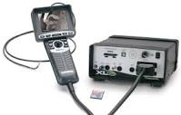
Borescope
FIBER OPTICS FLEXIBLE BORESCOPE

Slide 7
ULTRASONIC TESTING / INSPECTION
The use of ultrasonic waves to evaluate the condition of a material.
• Anomalies absorb or deflect the sound waves, which are then detected as changes in the waves.
– holes, delaminations,
voids – damage, debonds
– resin-rich,-poor areas

Slide 8
Through Transmission Mode
Detector
part
emitter
emitter detector

Slide 9
Reflected (pulse-echo) Transmission Mode
Reflected (pulse-echo)Transmission Mode emitter Emitter – Detector - Transreciver
Emitter/Detector
Reflector
part

Slide 10
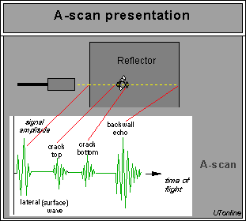
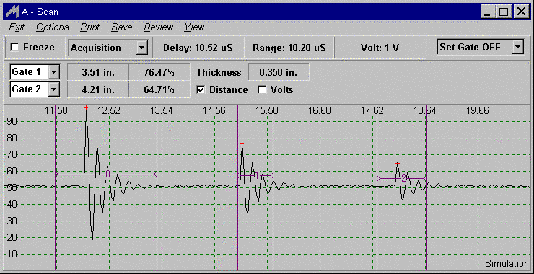
A-scan

Slide 11
A-scan (single pulse - ice pick)
• Received pulse amplitude is represented as a
displacement along one axis and the travel
time of the ultrasonic pulse is represented as
a displacement along the other axis.
• A-scan display are more complex because
all reflections are displayed, so signals (back
wall, water path) need to be carefully interpretated

Slide 12
B-scan (cross section)
• A two-dimensional graphical presentation, in rectangular coordinates, in which the travel time of an ultrasonic pulse is represented as a displacement along one axis, and transducer movement is represented as a displacement along the other axis

Slide 13
Ultrasonic Test Equipment C-scan
ENG 4793: Composite Materials and Processes

Slide 15
C-scan (defect location map)
• A two-dimensional graphical presentation, in
which the discontinuity echoes are displayed
in a top view on the test surface.
• This method is applied to pulse-echo and
through transmission techniques.
• Usually no indication of depth is given unless
the complete scan represents the time of
flight evaluation (D-scan).

Slide 16
C scan
ENG 4793: Composite Materials and Processes

Slide 17
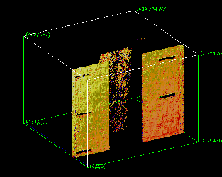
3D C-scan
ENG 4793: Composite Materials and Processes

Slide 18
D-scan (defect depth map)
A two-dimensional graphical
presentation, in which the time-of-flight
values are displayed in a top view on
the test surface. This is a modified Cscan
in which are amplitudes displayed.
ENG 4793: Composite Materials and

Slide 19
D-scan

Slide 20
D-scan (defect depth map)
• A two-dimensional graphical
presentation, in which the time-of-flight
values are displayed in a top view on
the test surface. This is a modified C scan
in which are amplitudes displayed

Slide 21
Processes 20
Performance
• 5-25 MHz typical
• 0.2- 800 MHz possible
• Trade-off between frequency
(resolution) and depth of penetration
– higher frequency, better resolution

Slide 22
D-scan of Test Block

Slide 23
22
Performance
• 5-25 MHz typical
• 0.2- 800 MHz possible
• Trade-off between frequency
(resolution) and depth of penetration
– higher frequency, better resolution, lower
depth of penetration

Slide 24
X-ray Technique
Film pack
or X-ray imaging
System
X-ray source
Test object
ENG 4793: Composite Materials and Processes

Slide 25
Micro focus X-ray Technique
Film pack
or X-ray imaging
System
Micro focus
X-ray source
Greatly Enlarged
image
Test object
ENG 4793: Composite Materials and Processes

Slide 26
Instrument for Microfocus X-ray
ENG 4793: Composite Materials and Processes

Slide 27
Real Time X-ray Technique
Fluorescent
screen
Intensifier
Image processor
Monitor scope
X-ray source
TV camera
Test object

Slide 28
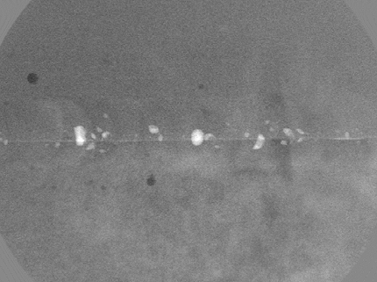
28 X-ray Images
Cooling lines in turbine blade and Porosity in weld

Slide 29
X-ray Images
IC chip
Computer mouse

Slide 30
CT Scan
• CT produces 3-dimensional images of objects
using x-rays.
• The scanner, made in the shape of a ring,
contains an x-ray tube that circles the object.
The object in the scanner is bombarded by xrays
from various angles and resulting
information signals are then processed by a
computer, yielding cross sectional slices
which then make up images.

Slide 31
C t scanner

Slide 32
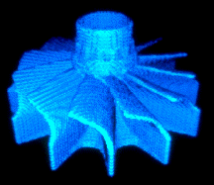
C t scan image

Slide 33
Aquastic technique

Slide 34
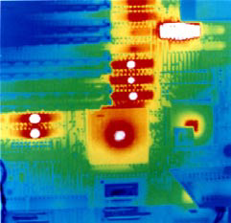
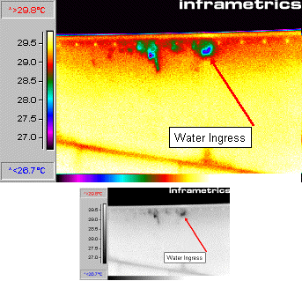
Thermographic image
PC board
Aircraft wing

Slide 35
Acoustic Emission Principle
• Sounds made by a material, structure, or
machine in use or under load are heard and
analyzed to determine its "state of health".
• One or more ultrasonic microphones are
attached to the object and the sounds are
analyzed using computer based instruments.
• Noises may arise from:
– friction (including bearing wear)
– crack growth
– material changes (such as corrosion)

Slide 36
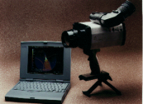
Heat
Source
IR camera
part

Slide 37
Acoustic emmission set up

Slide 38
Thermographic Principle
• Heat flow in a material is altered by the
presence of some types of anomalies.
• These changes in heat flow cause
localized temperature differences in the
material.
• Slow heating of part reveals these
anomalies.

Slide 39
36
Acoustic Emission Principle
• Sounds made by a material, structure, or
machine in use or under load are heard and
analyzed to determine its "state of health".
• One or more ultrasonic microphones are
attached to the object and the sounds are
analyzed using computer based instruments.
• Noises may arise from:
– friction (including bearing wear)
– crack growth
– material changes (such as corrosion
Heat
source Part IR camera

Slide 40
RollerFORM
RollerFORMThis new phased array wheel probe facilitates high-quality testing of composite materials (CFRP) offering a viable alternative to immersion techniques.

Slide 41
Weld Inspection Solutions
Weld Inspection Solutions
full range of weld inspection solutions provides unmatched capabilities for applications that include the location and sizing of hidden cracks, voids, disbonds, and similar discontinuities in welds, forgings, turbines, and other structural components. A wide range of measurement features and application-specific software options are available.
The PipeWIZARD is an automated girth weld inspection system using phased array and conventional UT techniques (AUT). Specially designed for in-site weld-to-weld inspection in extreme environments, on-shore and off-shore.

Slide 42
Advanced NDT Solutions
Advanced NDT Solutions
Industrial Scanners
Aerospace Inspection Solutions
Stress Corrosion Cracking Solutions
Transportation Solutions
Corrosion Inspection Solutions
Composite Inspection Solutions
Tube Inspection Solutions
Weld Inspection Solutions
Guided Wave Solutions
Flaw Detectors
Ultrasonic Flaw Detectors
Phased Array
Guided Wave
Eddy Current Products
Eddy Current Array Products
Bond Testing
Transducers and Probes
Pulser-Receivers
Scrap and Recycling XRF Analyzers
Applications Solutions Key
Integrated Inspection Systems
Bar Inspection Systems
Tube Inspection Systems
NDT Systems Instrumentation
Thickness Gages
27MG
45MG
38DL PLUS
Magna-Mike 8600
35RDC
Transducers and Accessories
Microscope Solutions
Laser Confocal Microscopes
Digital Microscopes
Semiconductor & Flat Panel Display Inspection Microscopes
Upright Metallurgical Microscopes
Inverted Metallurgical Microscopes
Modular Microscopes
Polarizing Microscopes
Measuring Microscopes
Stereo Microscopes
Objective Lenses
Digital Cameras
Image Analysis Software
OEM Microscope Components for Integration
Components & Custom Solutions
Objective Lenses
Optical Microscope Frames
Modular Microscope Assemblies
Optical Microscope Modules
Optical Metrology
Laser Confocal Microscopes
Digital Microscopes
Measuring Microscopes
Micro Spectrophotometer
Videoscopes, Borescopes
Industrial Videoscopes
Industrial Fiberscopes
Industrial Rigid Borescopes
Light Sources
Inspection Assist Software
Turning Tools
XRF Analyzers and XRD Analyzers
Handheld XRF Analyzers
Portable XRF Analyzers
Benchtop XRF Analyzers
Process XRF Analyzers
Portable XRD Analyzers
Benchtop XRD Analyzers
Alloys and Metals XRF Analyzers
Precious Metals XRF Analyzers

Slide 46
Acoustic Emission Advantages
• Entire structure can be monitored from a few
locations.
• Structure can be tested in use.
• Continuous monitoring with alarms is
possible.
• Microscopic changes can be detected if
sufficient energy is released.
• Source location is also possible using
multiple sensor

Slide 47
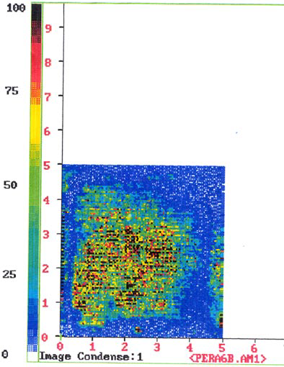
ENG 4793: Composite Materials and Processes

